Slide 1
Adult Income
Author: Gabrielle Ray

Slide 2
Business Problem
The “Adult” dataset focuses on predicting an individual’s income based on their personal information.

Slide 3
Data Source
This data set named “Adult” is by The University of California, Irvine. The dataset is located in their UCI repository of machine learning databases. The dataset is based on the 1994 US Census Bureau data.
The detailed description of the dataset can be found in the UCI original documentation
The dataset contains 16 columns
The target column: Income
“Income” is divided into two categories: < = 50k or > 50k

Slide 4
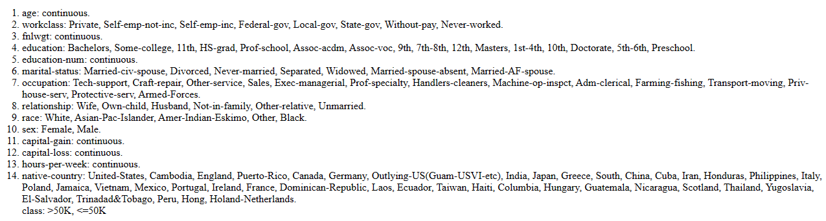
Data Description:

Slide 5
Adult Income Prediction
“ Adult income predictions can be useful for analyzing the income distribution and inequality in a population, or or targeting potential customers or donors for a business or a charity”
Sourced: Machine Learning Mastery.com

Slide 6
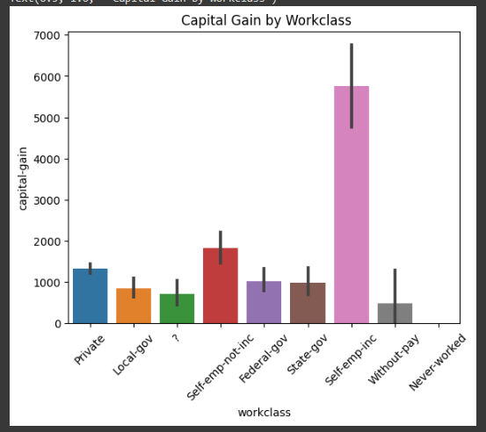
Comparing Capital Asset Increase to Workclass:
Individuals who are Self Employed had the highest capital gains. This is about $5,800
Individuals who have never worked did not have any capital asset increase
Independent contractors have the second highest Capital asset gain of about $2,000

Slide 7
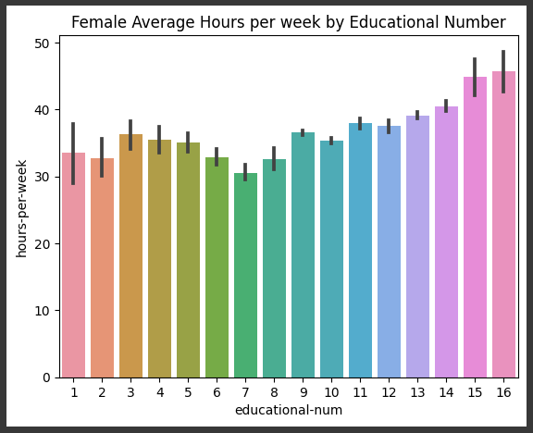
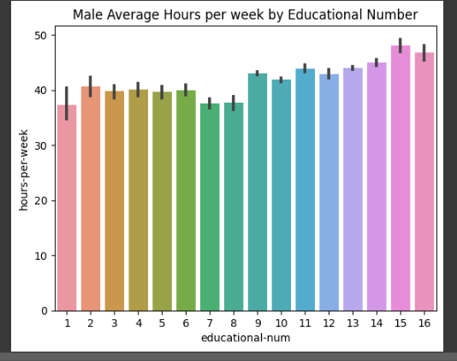
Comparing Males and Females Education and Working Hours
Women with the max of 16 years of education, worked the most of about 45 hours a week
Men with the education years of 15, work the more hours than everyone else
All Men worked at least 35 hours per week despite there years of education
All Women worked at least 30 hours a week
Men worked more than Women
Both Men and Women with 7 years of education worked the least amount

Slide 8
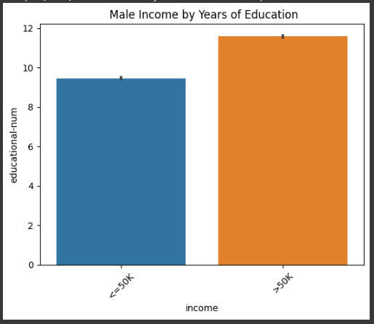
Comparing Males’ Capital gain by Income
Men with about 12 years of Education makes at least 50k or above
Men with about 9 years of education make at 50k or less

Slide 9
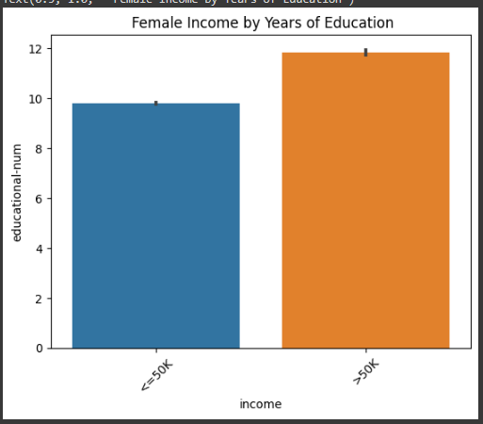
Comparing Females’ by Income by Education
Women with about 12 years of education make 50k or above
Women with at least 10 years of education and that make 50k orless
Women tend to go to school longer than Men

Slide 10
Final Model Evaluation
The best model chosen, to predict an adult’s income level based on their personal information is the Logistic Regression Model. The model was able to correctly predict 0.60% of adult’s income.

Slide 11
Stakeholder Recommendations
Adding additional data can possibly increase the model’s positive prediction.
However, using this model to predict adult’s income could result into further Income Inequality. Meaning , if the model predicts a category of individuals with lowers income rates with high income rates. What is being analysed to help people with lower income can actually hurt them and cause poverty rates to increase.

